Slide 1
High-Quality Vaccine Development Powered by Quality Control Using Automated Electrophoresis
Agilent Fragment Analyzer and TapeStation Systems

Slide 2
Table of Content
Nucleic acid sample QC introduction
mRNA vaccine
DNA vaccine
Agilent Solutions
Importance of nucleic acid vaccine QC
The advantage of automated electrophoresis
IVT RNA preparation workflow
Screening of DNA Template
Screening of the IVT RNA Product
Addition of a PolyA Tail
Quality Control Checks of Final Product
DNA vaccine workflow
Amplify and Isolate DNA of Interest
Plasmid Purification
Final Product
Agilent Fragment Analyzer Systems
Agilent TapeStation Systems
Summary
Resources

Slide 3
Nucleic Acid Sample QC Introduction

Slide 4
Importance of Nucleic Acid Vaccine QC
Sample quality control (QC) analysis is an essential part of the in vitro transcription (IVT) RNA and DNA vaccine workflow.
Utilizing sample QC checkpoints at critical junctures in the process identifies unsuitable samples, saves time and money, and thereby maximizing resources
Unsuitable samples may result from:
Insufficient PCR amplification
Suboptimal plasmid linearization
Poor transcription
DNA template contamination of RNA
Degraded RNA
Sample QC ensures that downstream applications are starting with high-quality nucleic acids

Slide 5
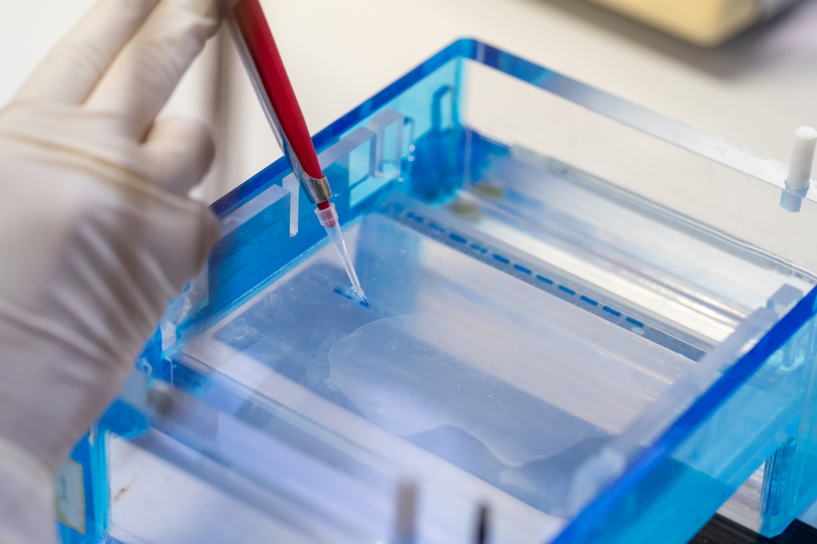
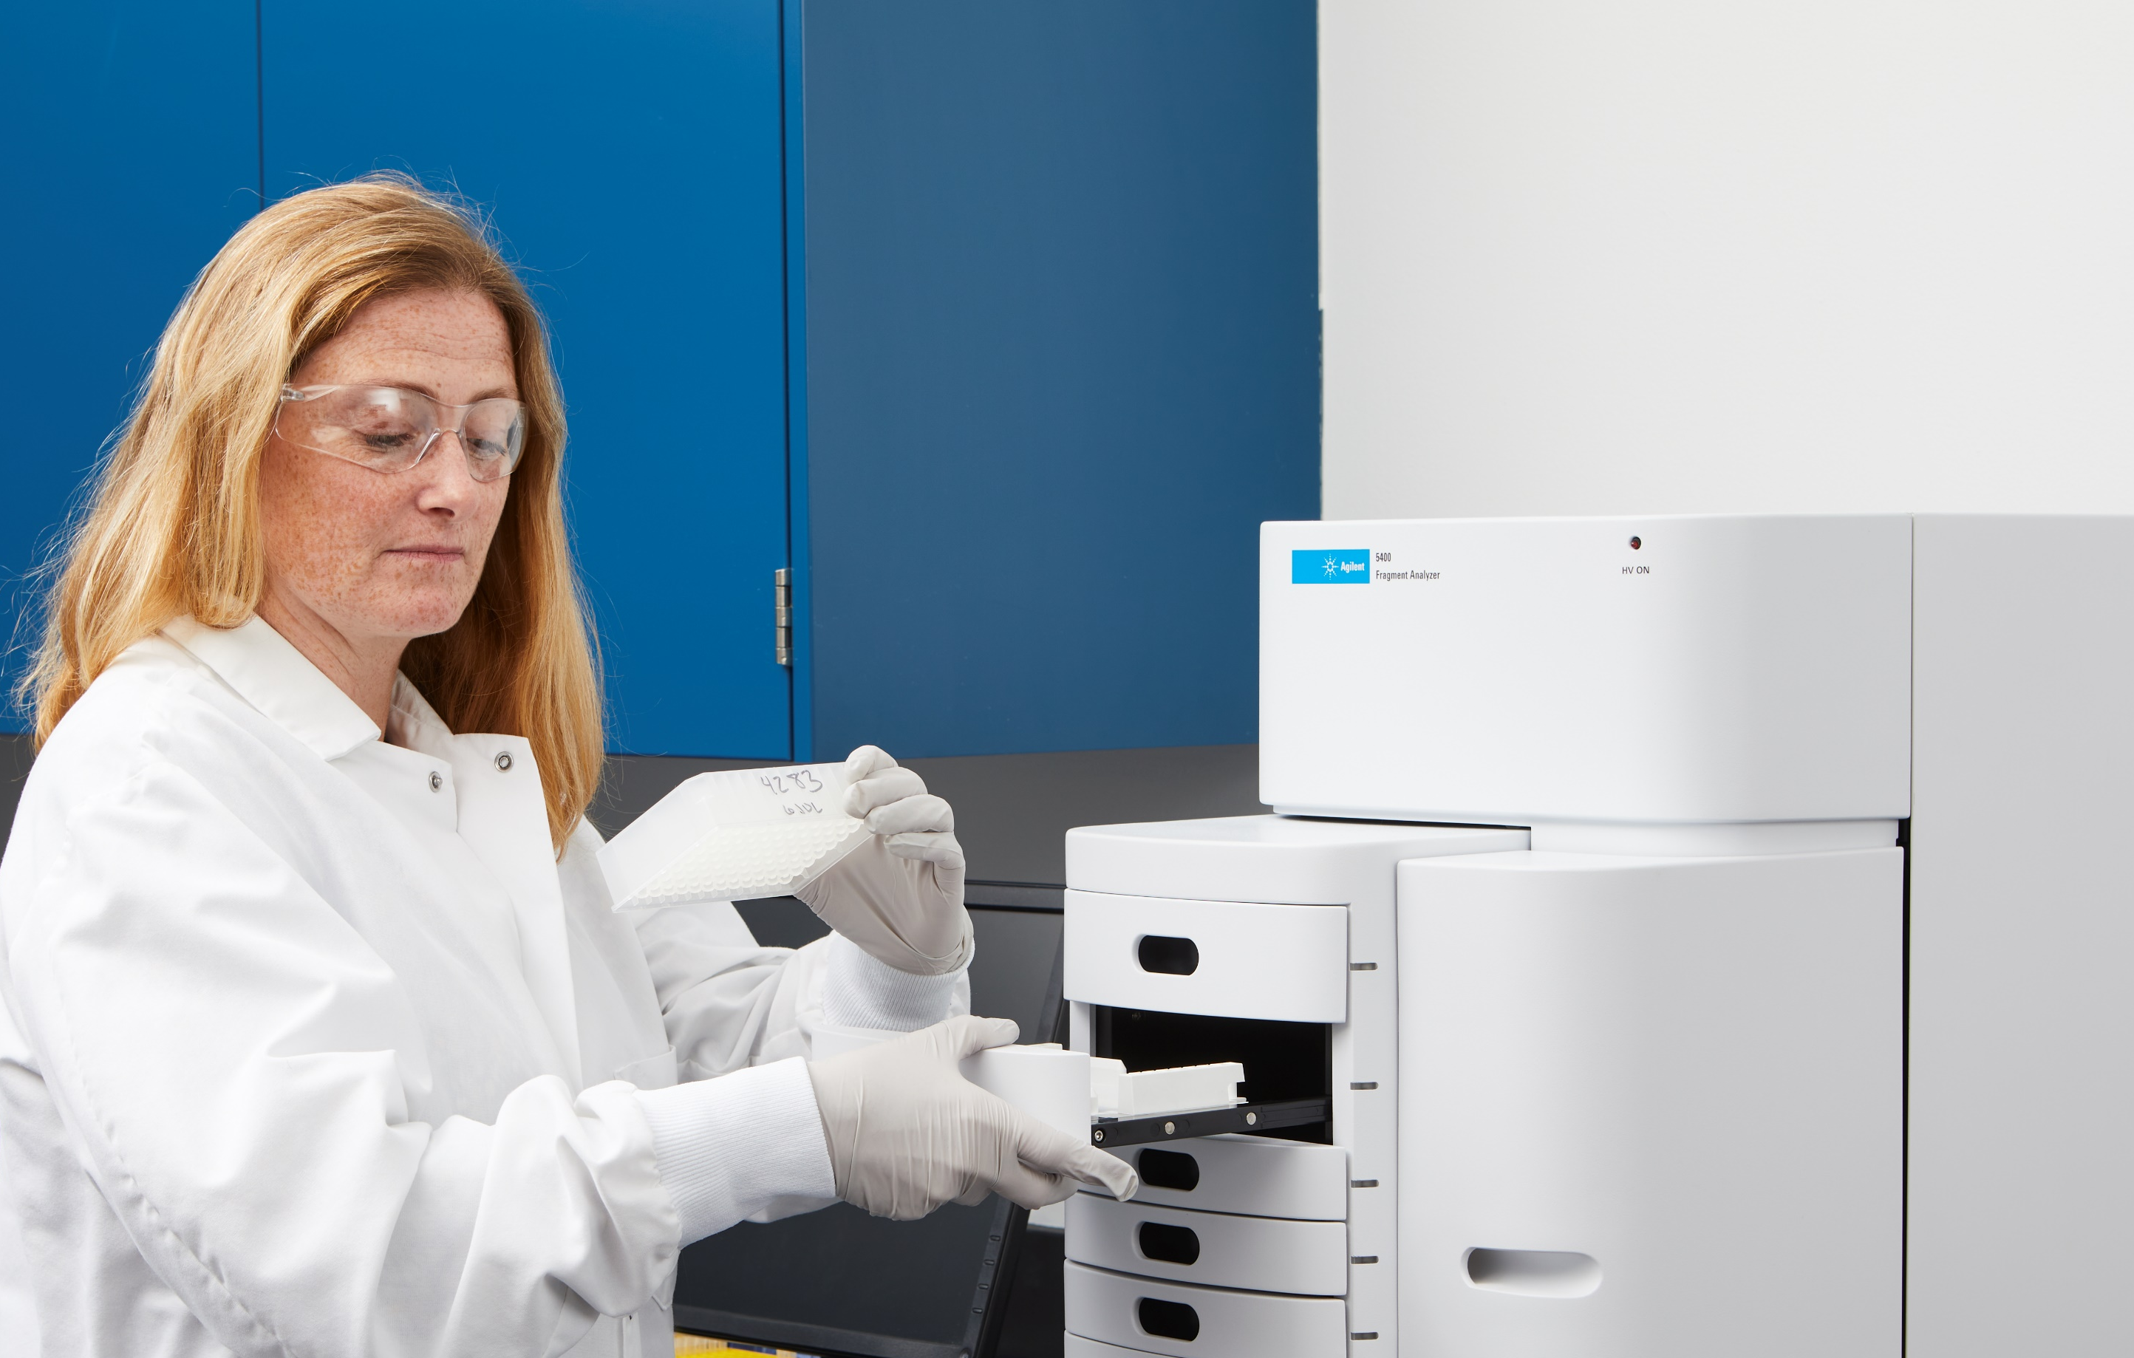
The Advantage of Automated Electrophoresis
Manual
Automated
Agarose or acrylamide gels for DNA and RNA analysis are:
Time-consuming
Laborious
Error-prone
An automated solution for nucleic acid analysis improves lab efficiency by:
Faster time to results
Objective, accurate and digital data
Flexible throughput options

Slide 6
mRNA Vaccine
Workflow

Slide 7
IVT RNA Preparation Workflow
Process optimization
QC step 1: DNA template
Synthetic DNA starting material can be made from linearized plasmids or PCR amplification.
QC step: Purity of PCR product and plasmid restriction digest screening
Synthetic DNA starting materials
QC 1
In vitro transcription
QC step 2: IVT RNA product
In vitro transcription (IVT) reactions need to be optimized to ensure the proper full product is produced with acceptable purity.
QC step: Qualitative and quantitative analysis of final product
RNA cleanup
QC 2
QC step 3: Addition of a polyA tail
A polyA tail is added to the purified IVT product to increase stability.
QC step: Screening for tail length and quality to ensure degradation has not occurred
Addition of polyA tail
QC 3
Formulation of RNA delivery system
QC step 4: Final product
The final product is formulated and ready for shipment.
QC step: Screening for RNA stability and degradation
QC 4
Final product
Notes:
Blue arrows indicate that depending on the results of the QC checkpoint this step may have to be repeated.

Slide 8
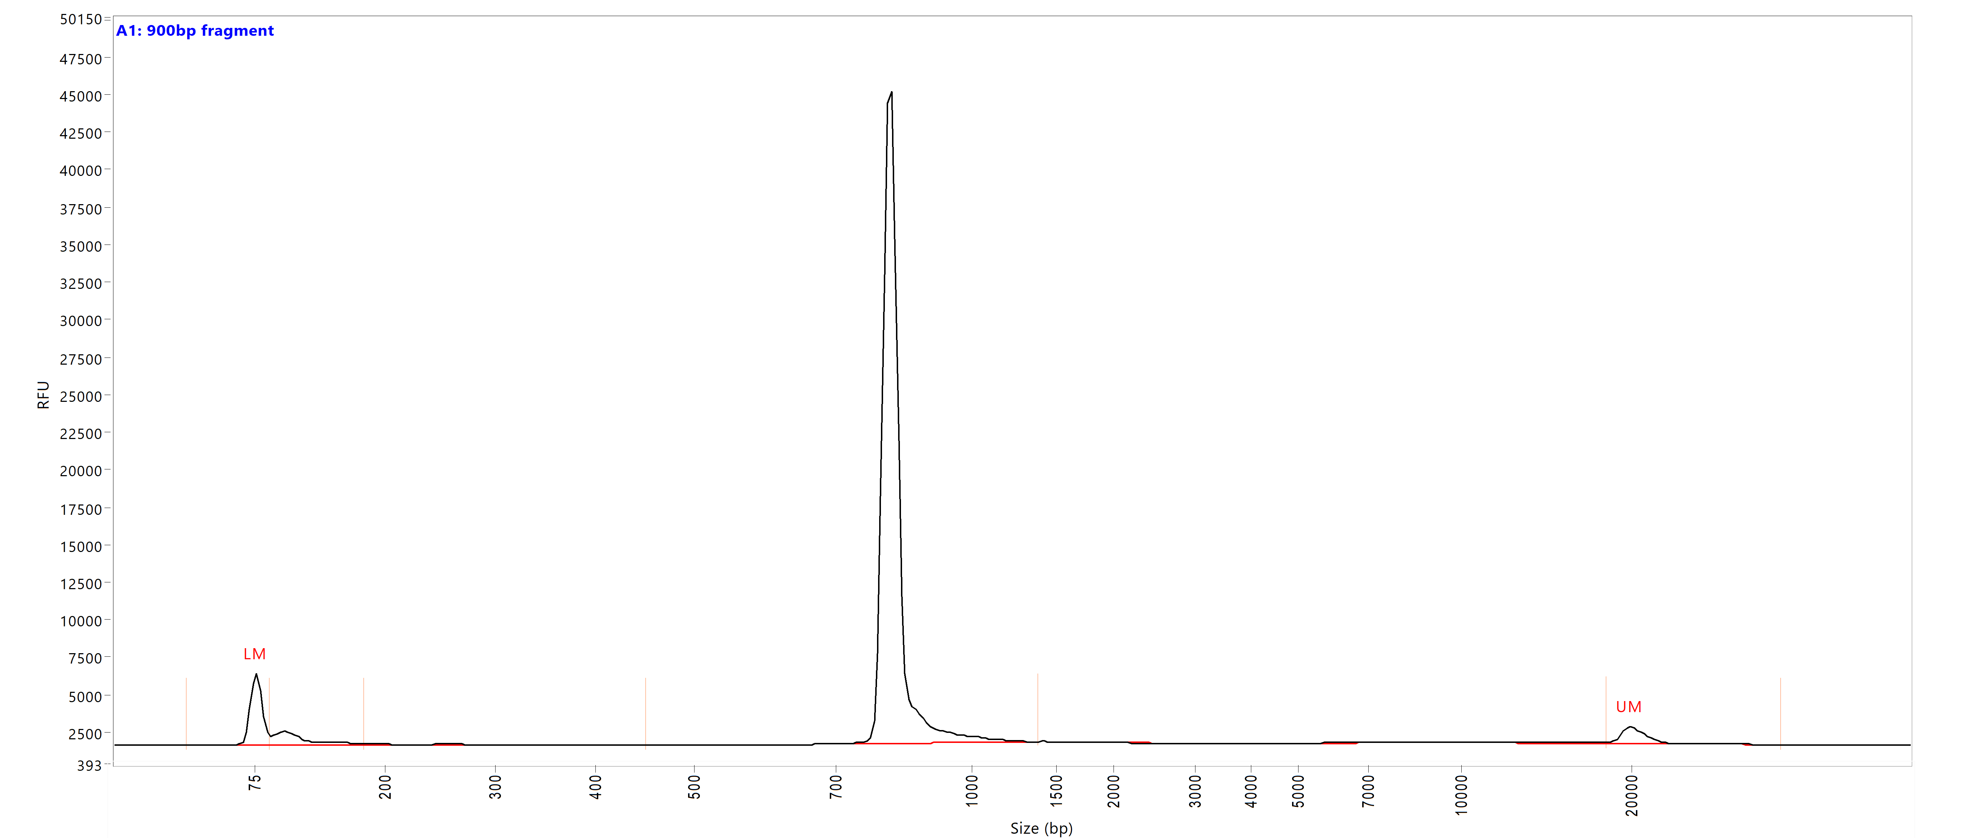
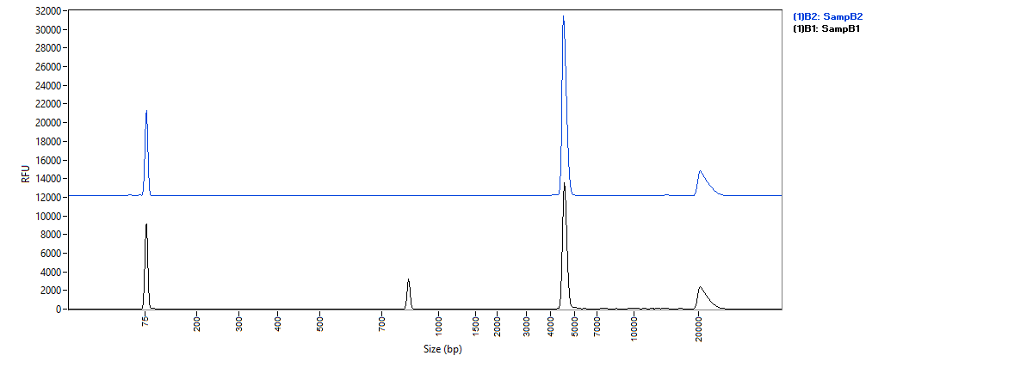
QC 1: Screening of DNA Template
Process optimization
Synthetic DNA starting materials
QC 1
PCR product purity
In vitro transcription
RNA cleanup
QC 2
Vector Backbone
Addition of polyA tail
Plasmid restriction
digest screening
QC 3
Insert
Formulation of RNA delivery system
Fragment Analyzer quantitative or qualitative kits can be used for fragment screening and plasmid restriction digest screening.
QC 4
Final product

Slide 9
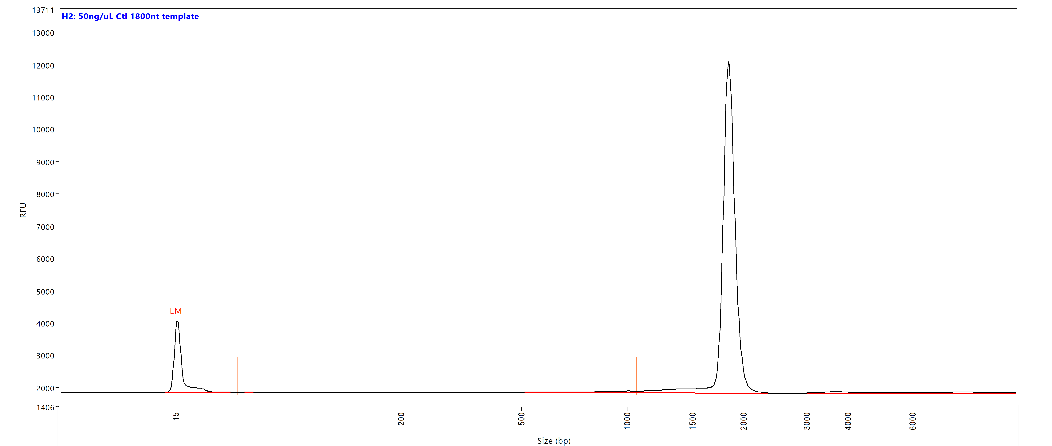
QC 2: Screening of the IVT RNA Product
Process optimization
Synthetic DNA starting materials
1849 nt observed
1800 nt theoretical
QC 1
In vitro transcription
RNA cleanup
QC 2
Addition of polyA tail
QC 3
The DNF-471 RNA Kit (15 nt) can be used for the assessment of the quality
and concentration of IVT RNA.
This analysis allows for the detection of incompletely transcribed RNA products enabling optimization of the IVT reaction.
Formulation of RNA delivery system
QC 4
Final product
Application note 5994-0512EN
Application note 5994-0878EN

Slide 10
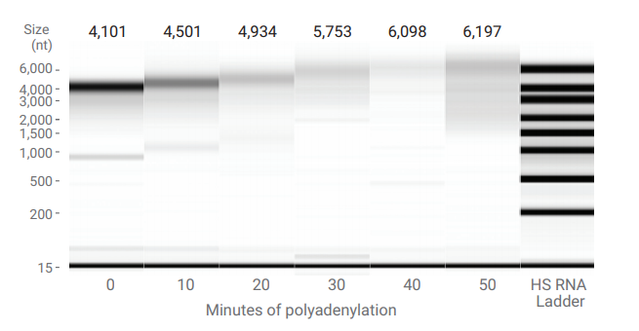
QC 3: Addition of a PolyA Tail
Process optimization
Synthetic DNA starting materials
QC 1
In vitro transcription
RNA cleanup
QC 2
Addition of polyA tail
QC 3
Formulation of RNA delivery system
The addition of a polyA tail increases the half-life of the RNA once it has entered the targeted cells.
Electrophoretic QC allows for the monitoring of the approximate length of the polyA tail as well as monitoring for any degradation occurring.
QC 4
Final product
DNF-471 or 472 RNA kits can be used to screen for addition of the polyA tail.
For Research Use Only. Not for use in diagnostic procedures. PR7000-8294

Slide 11
QC 4: Quality Control Checks of Final Product
Process optimization
Synthetic DNA starting materials
1849 nt observed
1800 nt theoretical
QC 1
In vitro transcription
RNA cleanup
QC 2
Addition of polyA tail
QC 3
Formulation of RNA delivery system
The DNF-471 RNA Kit (15 nt) can be used for the assessment of the quality
and concentration of IVT RNA up to 6000 nt without modification.
QC 4
Final product

Slide 12
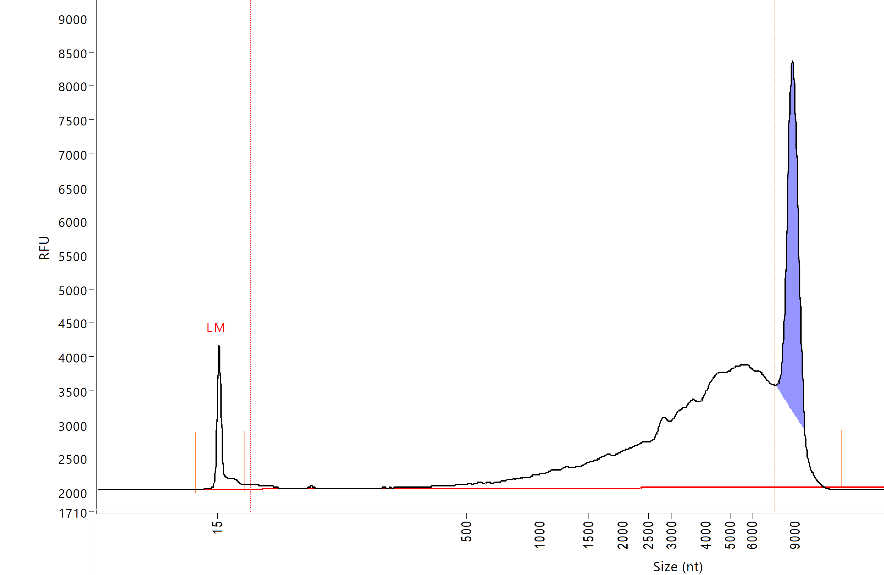
QC 4: Quality Control Checks of Final Product
Process optimization
Synthetic DNA starting materials
Desired product
QC 1
Degraded IVT product
~70% of total
In vitro transcription
RNA cleanup
QC 2
Addition of polyA tail
QC 3
Formulation of RNA delivery system
The amount of degradation can be determined using the ProSize data analysis software smear function.
QC 4
Final product

Slide 13
DNA Vaccine
Workflow

Slide 14
DNA Vaccine Workflow
Amplify and isolate DNA of interest
QC 1
QC step 1: Amplified DNA
Plasmid construction involves amplifying the target of interest and ligating this DNA sequence into the appropriate plasmid. The plasmid is transformed into a bacterial host that creates mass quantities of the plasmid of interest.
QC step: Screen PCR reactions for size and purity
Ligate into plasmid
Transform into
bacteria
QC step 2: Plasmid purification
Plasmid purified from the bacteria must be screened to ensure it contains the inserted DNA. Plasmid topology is also analyzed to quantitate the percent supercoiled.
QC step: Plasmid restriction digest product screening
QC 2
Purify plasmid
Formulate DNA
vaccine
QC step 3: Final product
After formulating the DNA plasmid into a delivery particle, the final product must be screened for the presence of the desired plasmid as well as topology.
QC step: Restriction digest, supercoiled plasmid sizing
QC 3
Final product
For Research Use Only. Not for use in diagnostic procedures. PR7000-8294

Slide 15
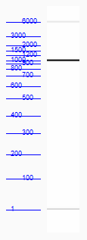
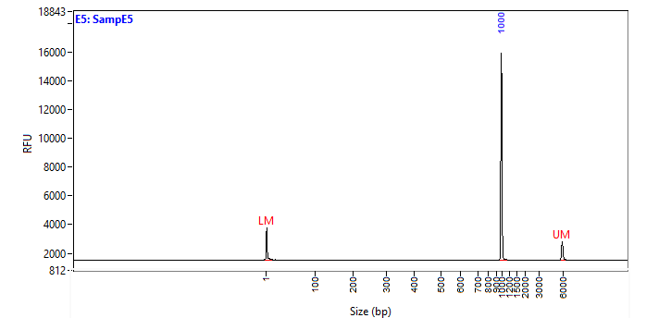
QC 1: Amplify and Isolate DNA of Interest
PCR product screening
QC 1
Amplify and isolate DNA of interest
Ligate into plasmid
Transform into
bacteria
QC 2
Purify plasmid
Formulate DNA
vaccine
Fragment Analyzer quantitative or qualitative kits can be used to screen PCR reactions for size and purity. These can be used to screen both the raw PCR reaction and after cleanup steps.
QC 3
Final product
For Research Use Only. Not for use in diagnostic procedures. PR7000-8294

Slide 16
QC 2: Plasmid Purification
Plasmid restriction digest product screening
Amplify and isolate DNA of interest
QC 1
Vector backbone
Ligate into plasmid
Transform into
bacteria
QC 2
Purify plasmid
Insert
Formulate DNA
vaccine
Fragment Analyzer qualitative kits can be used to screen plasmid restriction digests to identify plasmids containing the inserted sequence.
Plasmid topology cannot be measured at this time by the Fragment Analyzer.
QC 3
Final product
For Research Use Only. Not for use in diagnostic procedures. PR7000-8294

Slide 17
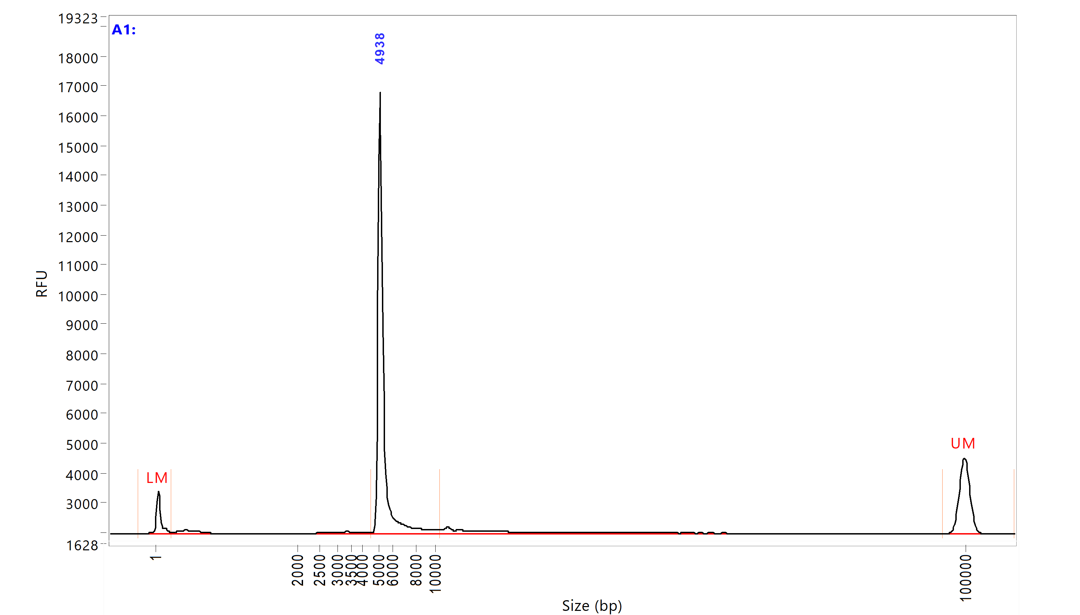
QC 2: Plasmid Purification
Supercoiled plasmid sizing
Amplify and isolate DNA of interest
QC 1
Ligate into plasmid
Transform into
bacteria
QC 2
Purify plasmid
Formulate DNA
vaccine
The Fragment Analyzer Plasmid kit can be used to screen supercoiled plasmids for size and purity of the purified plasmid. Plasmid topology cannot be measured at this time by the Fragment Analyzer.
QC 3
Final product
Application note 5994-4241EN
For Research Use Only. Not for use in diagnostic procedures. PR7000-8294

Slide 18
QC 3: Final Product
Restriction digest, supercoiled plasmid sizing
Amplify and isolate DNA of interest
QC 1
Ligate into plasmid
Transform into
bacteria
The final DNA plasmid product undergoes quality control checks including sizing and restriction digests. These sample QC checks are the same as those completed during the construction of the plasmid (QC 2).
QC 2
Purify plasmid
Formulate DNA
vaccine
QC 3
Final product
For Research Use Only. Not for use in diagnostic procedures. PR7000-8294

Slide 19
Agilent Solutions

Slide 20
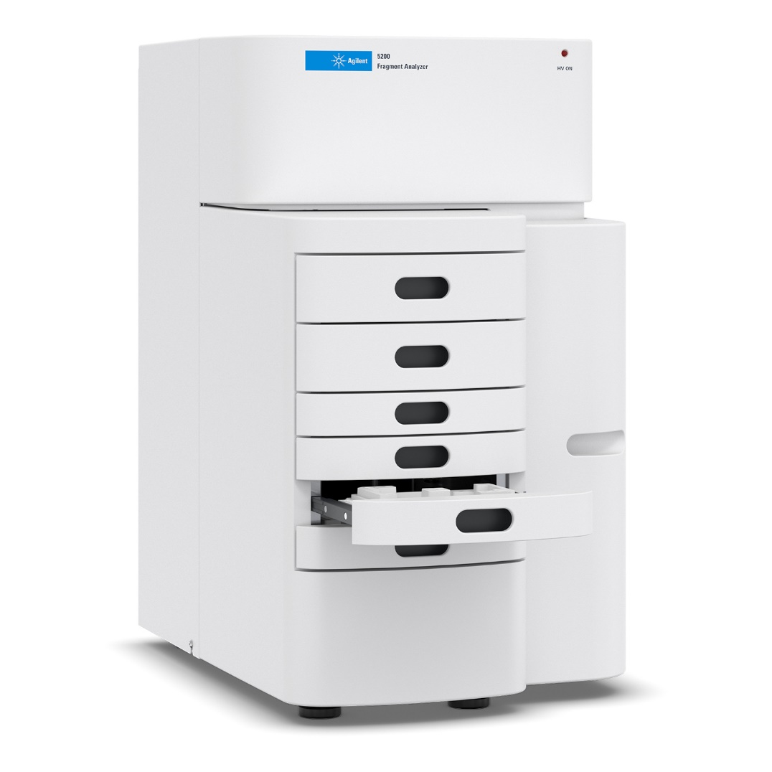
Agilent Fragment Analyzer Systems
Overview
3 benchtop models with different throughput options
Kits for RNA with specialized IVT RNA methods, DNA fragments, supercoiled plasmids, and NGS workflows
Qualitative and quantitative kits
6 array formats, customer choice for speed or resolution
For Research Use Only. Not for use in diagnostic procedures. PR7000-8294

Slide 21
Agilent Fragment Analyzer Systems
Instrument models
Agilent 5200 Fragment Analyzer
Agilent 5300 Fragment Analyzer
Agilent 5400 Fragment Analyzer
12 capillary array
Sample trays for 3x96-well plates
Agilent quality metrics
48 capillary array
96 capillary array
Sample trays for 3x96-well plates
Agilent quality metrics
96 capillary array
Interface with a robotic arm
Operational software features
APL commands
LIMS capabilities
Automated data analysis
Agilent quality metrics
Automated gel switching
For Research Use Only. Not for use in diagnostic procedures. PR7000-8294

Slide 22
Agilent Fragment Analyzer Systems
Features and benefits
The Fragment Analyzer Systems utilize automated parallel capillary electrophoresis to provide reliable quality control for nucleic acids.
Features & Benefits
Unattended operation
Up to three 96-well plates,
or 288 samples, without
human intervention
Decreased platform preparation time
Room temperature stable reagents and no daily array handling
Method optimization
Change injection and electrophoresis conditions to optimize for unique sample needs
Low cost per sample Qualitative or quantitative gel kits that best suit your
analysis needs
Application note 5994-0878EN
For Research Use Only. Not for use in diagnostic procedures. PR7000-8294

Slide 23
Resources
Technical and application notes
Resolution of the Fragment Analyzers
Analysis of IVT RNA on the Fragment Analyzer Systems
Analysis of Long IVT RNA on the Fragment Analyzer Systems (method optimization)
Analysis of IVT sgRNAs on the Fragment Analyzer Systems
Analysis of IVT Cas9 mRNA
Plasmid Analysis Using the Agilent Fragment Analyzer Systems
White paper
Quality control steps for viral sequencing
Publications
BNT162b vaccines protect rhesus macaques from SARS-CoV-2
A single dose of self-transcribing and replicating RNA-based SARS-CoV-2 vaccine produces protective adaptive immunity in mice
A deletion in SARS-CoV-2 ORF7 identified in COVID-19 outbreak in Uruguay
A multiplexed, next generation sequencing platform for high-throughput detection of SARS-CoV-2

Slide 24
Agilent Fragment Analyzer and TapeStation Systems
www.agilent.com/genomics/automated-electrophoresis

